Slide 1
The Exciting Evolution of Creighton’s Web Presence
Logon @ Lunch
Feb. 8, 2022
Notes:
Thank you so much for attending this session of Logon @ Lunch.
The website redesign and migration project has been and continues to be a huge undertaking, so we really appreciate your patience and tenacity through all of this change!
We are so excited to continue moving forward setting Creighton up for success.

Slide 2
Two Websites
my.creighton.edu
Our Intranet
Serves current students, faculty, and staff.
www.creighton.edu
Our Marketing Website
Serves prospects, alumni, community, also has overlap with internal audiences.
Set https://my.creighton.edu as your default home page in any browser
Notes:
Moving forward, we have two websites to serve the needs of the university.
my.creighton.edu which is our intranet
www.creighton.edu which is our marketing website
Both are currently at the starting line, not the finish line, so that is what makes this evolution so exciting!
(While also a little nerve wracking with so much change to adapt to!)
As part of the internal Creighton Community, we recommend you set your default home page to my.creighton.edu as it will be your front door to any internal pages.
Whereas our marketing site is the front door to the university for prospective students, alumni and the community.
Some of our web pages are a benefit to both internal and external audiences, so we’ve placed those on the marketing site in order to make them available to everyone.
Examples – The Creighton EDGE, Public Safety or the Creighton Libraries.
These areas serve the university but are also selling points and benefits to external audiences.
We understand there are other website services available for internal users such as Blueline, the Nest, myHR and those aren’t changing as part of this project, but they are big considerations for integrating into the intranet at some point in the future. Lots of opportunities for growth!

Slide 3
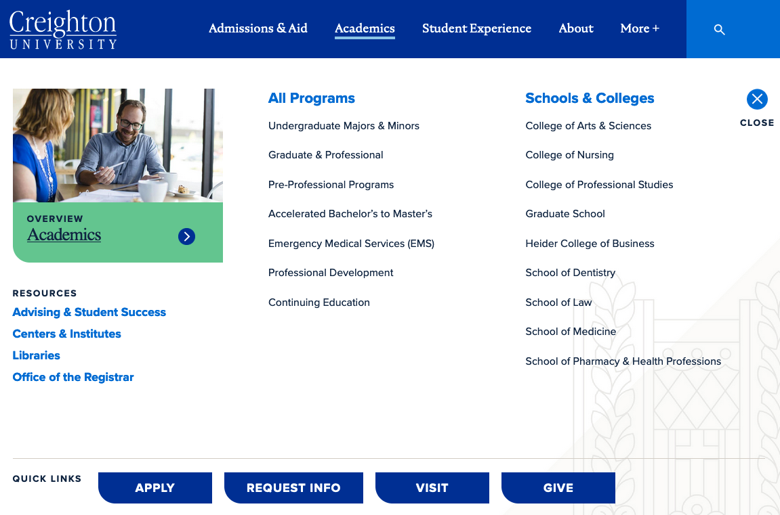
What’s New with creighton.edu?
New design and branding
University level top navigation
Mega menus upon hover
Individual section navigation on the left
More links available for longer navigation
Notes:
I’m sure you’ve all noticed the new design and branding. This was a much-needed redesign that will be utilized on all web pages so we have a unified look across the board.
The top navigation is the global navigation for the entire university.
Our user research informed us that our users struggled with the main navigation constantly changing as they navigated to a subdomain like business.creighton.edu or admissions.creighton.edu. By having only one marketing website, this main navigation is consistent throughout the user experience so users are always able to get back to the university level content easily.
Mega menus appear upon hover which allows the users to see what lives under the main navigation link before they click on anything. Users can get to the content faster because many of the most frequently used subpages are available in the hover menu.
Each section of the website has left navigation specific to their area. Where Arts and Sciences previously had top navigation and left navigation, it all now lives in the left navigation.
In some instances, there are more than 6 links in the left navigation which can be accessed by clicking the “More links” just under the last visible navigation item.

Slide 4
What’s Next for creighton.edu?
Launch phase 2 pages on the new platform
Continuous analytics & SEO assessments
Phased content and navigation reviews
Notes:
The next priority for the marketing website is to move the remainder of the pages onto the new website.
Planning is underway for the sequencing and timelines of this work and should be solidified by the end of next week.
We will be reviewing data analytics to inform us of any improvements that should be made with navigation, user experience and search engine optimization (or SEO for short). It’s both an art and a science to balance where we want users to go with where they are actually going. Data analytics really gives us insights into where a user path is working and also where it needs improvement.
With over 6,000 pages on our marketing website, we knew we could not do a full content review and launch the new site in one year.
Our phased approach was to move all the current and necessary content to the website first, then take time to do a deeper dive reviewing the content with each of our campus partners.
Plans for the sequencing and timelines of this work will also be solidified by the end of next week.

Slide 5
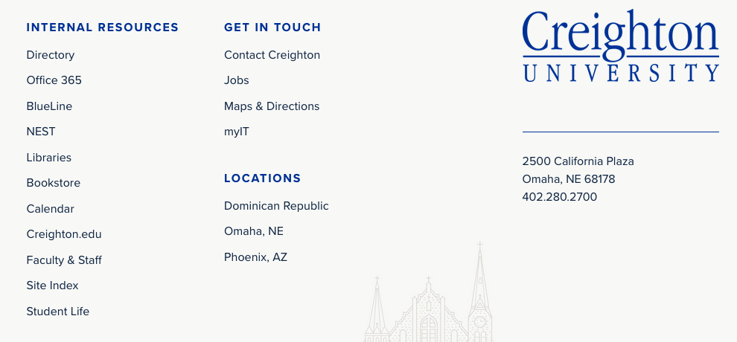
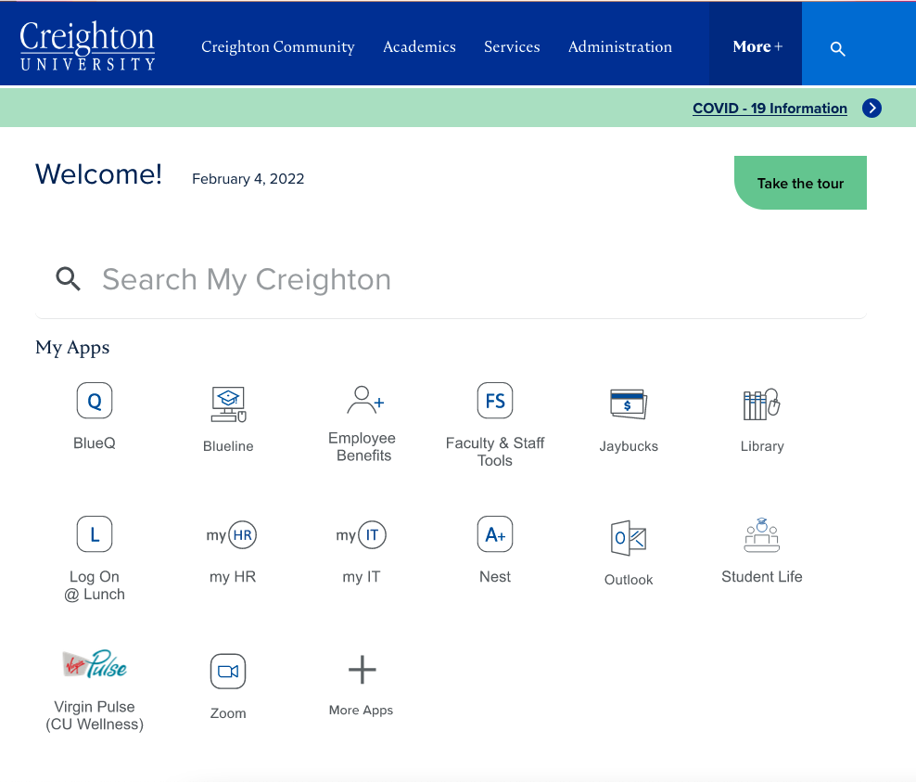
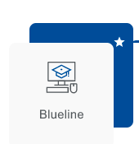
What’s New with my.creighton.edu?
New design and branding
University level top navigation
Search as a navigation
My Apps section which can be customized per user
Additional links in footer
Content updates: creighton.edu/ucom/web
Notes:
The intranet also takes on the new design and branding, as will all internal pages as they migrate into this new platform.
The top navigation and mega menus are global navigation for the entire university and will be revised and improved over time using data and user feedback.
There is also quick link to the COVID-19 info just below the main navigation.
The best way to navigate the my.creighton.edu website is by using the search tool.
The large search field on the page and search icon in the header are identical, so you can use either.
This searches both my.creighton.edu and www.creighton.edu so you can find content no matter which site in lives on.
Customize the “my apps” section to include your most used pages or applications for quick access.
Click More Apps and then hover over the app icon and click the star icon in the top-right corner to add or remove the icons from your home page.
If you scroll to the footer at the bottom of the page, there is a link to get to www.Creighton.edu, as well as many other internal resources including the Faculty and Staff page or the site index.
For now, all content updates for internal pages will continue to follow the same process as before the launch. Submit web requests to Creighton.edu/ucom/web.

Slide 6
What’s Next for my.creighton.edu?
Migrate internal pages to the new platform
Create single sign on login for all internal pages
Future integrations with other systems
Continuous improvements on search and navigation
Notes:
The next priority for the intranet is to move all of the internal pages onto the new website, allowing us to have a consistent look and feel across both the marketing and intranet websites.
Planning is underway for this work and should be solidified next week.
All internal pages will be behind an SSO login (or signle sign on using your netID and Blue password) so that they no longer appear in Google search and are not available externally which may confuse prospective students.
We will be reviewing user feedback and search analytics to inform us of any improvements that should be made with the navigation and search tool for the intranet.
With new technology comes new opportunities for integrations to help our Creighton community work more efficiently within the tools we provide. Lots of ideas have been tossed around, and we are excited to see where we can create a seamless experience for our internal users.

Slide 7
Empowering Content Editors
Editor access for campus partners
Training for using the content management system
Notes:
For both the intranet and the marketing website, we want to create efficiencies for updating content in real-time.
We will work with campus partners to identify editors for specific sections of the website and we’ll provide training for making content edits in the new content management system.
Plans are still in the works to roll out this editor access, so we’ll be in touch with more information in the coming months.

Slide 8
Contacts
Technical issues? Call the service desk at x1111
Website content updates? Use our Web Request form at creighton.edu/ucom/web
Beth Cavanaugh Director, Web Strategy
Dana Perkins Richardson Asst. Director of Digital Transformation
Notes:
With projects this large, there are bound to be some hiccups.
To serve you best, please contact the service desk for any technical issues you encounter.
If you need content on your web pages updated on either the intranet or the marketing website, please submit a web request, or work with the UCOM strategist within your school or college.
But don’t worry if you aren’t sure which route to use. We will route it to the correct place to ensure your request is taken care of.

Slide 9
Notes:
Q & A if there is time.

