Slide 1

Blue q Log On @ lunch
January 25th, 2023
12:00 p.m.
https://creighton.zoom.us/j/93807391526

Slide 2
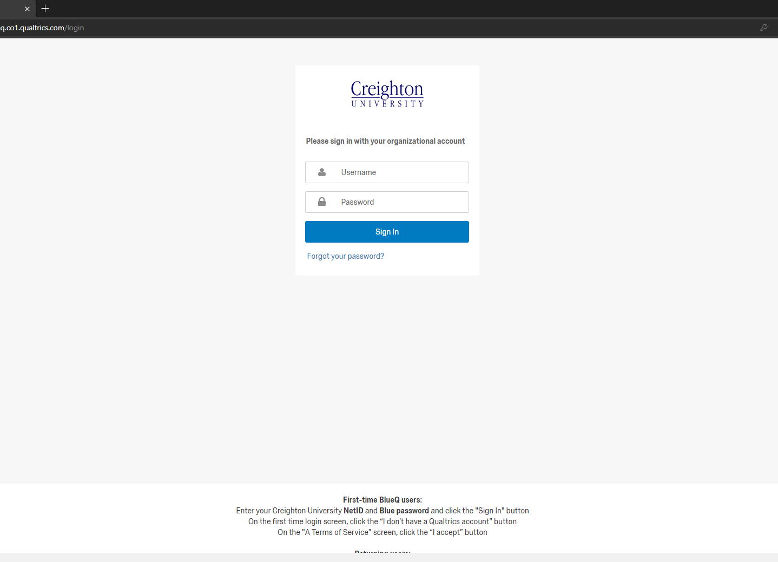
Logging In
https://blueq.co1.qualtrics.com/login
Creighton NetID & password
1st time-follow steps

Slide 3
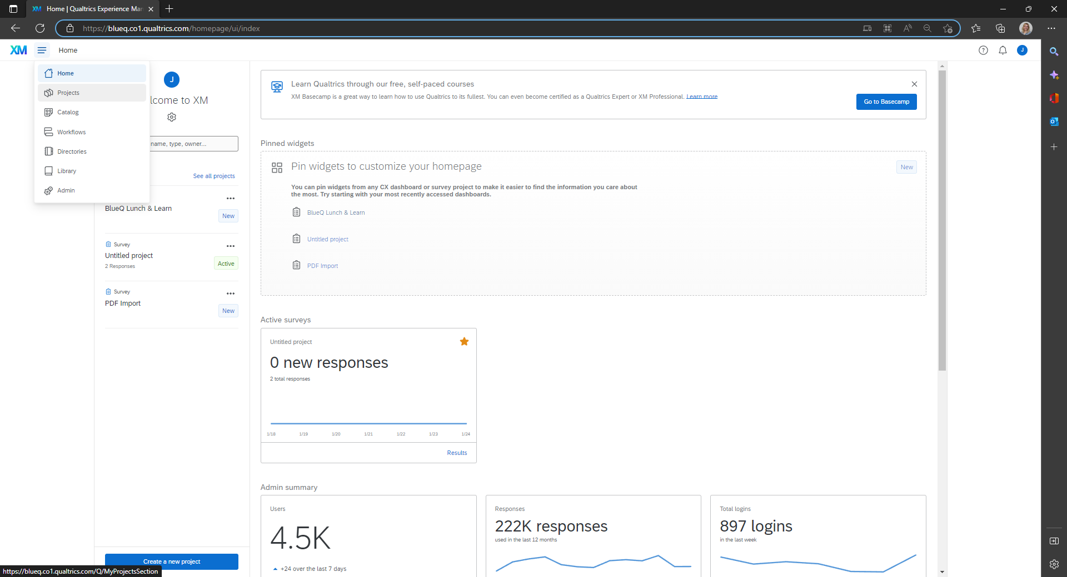
Accessing Projects

Slide 4
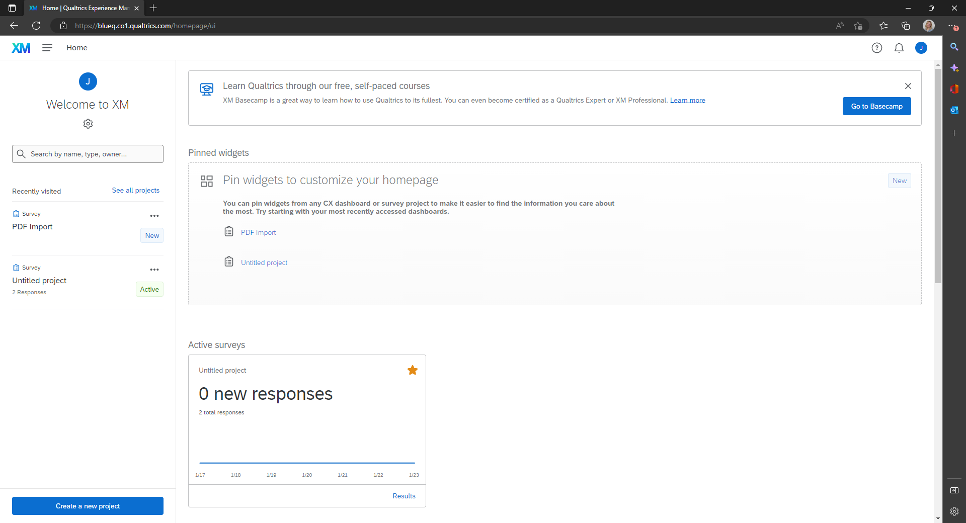
Creating a Survey: Getting Started
Creating a Project (qualtrics.com)

Slide 5
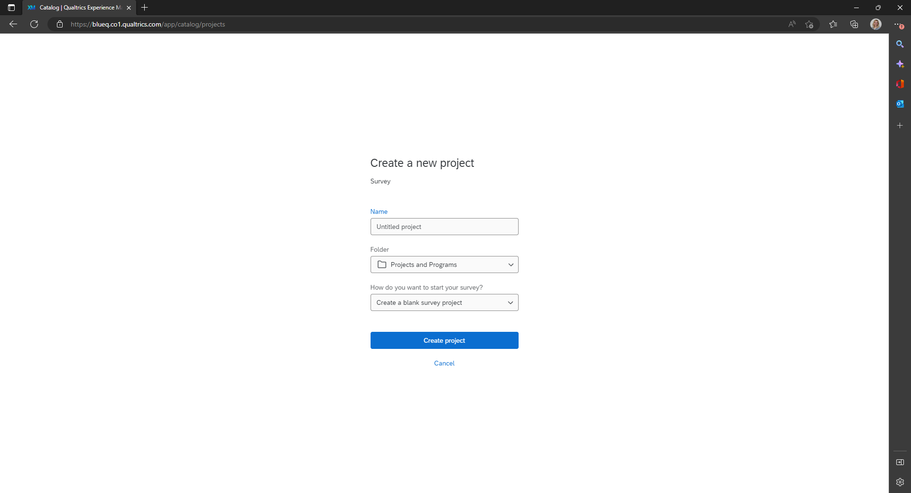
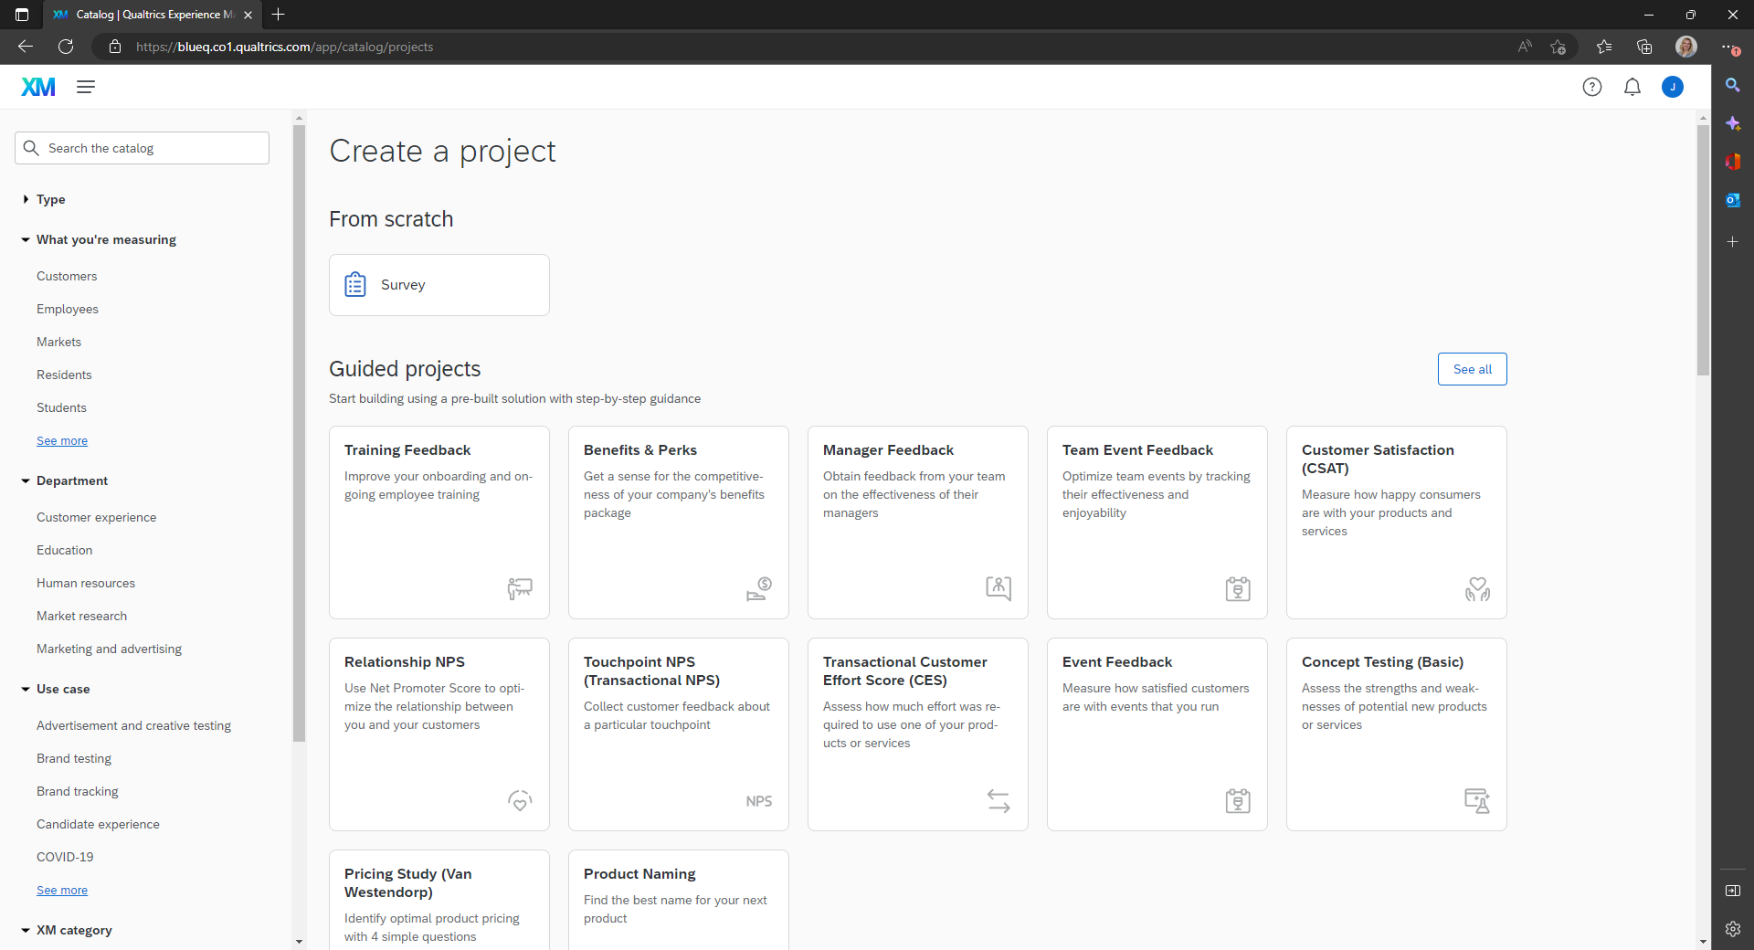
Creating a Survey: Templates
Creating from a Template (qualtrics.com)

Slide 6
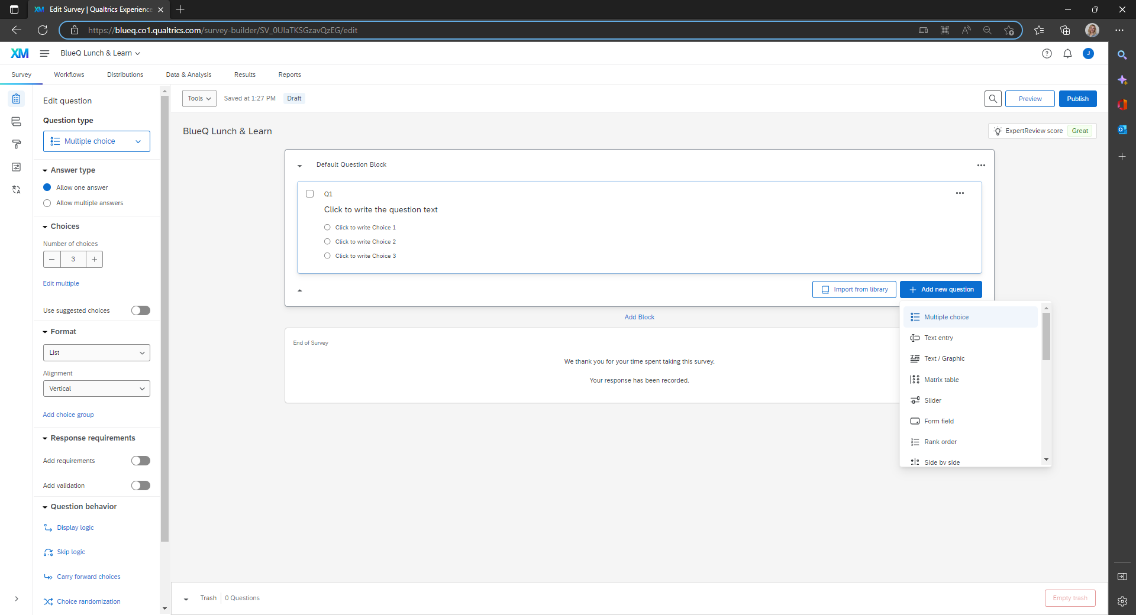

Creating a Survey: Adding Questions
Question Types (qualtrics.com)

Slide 7
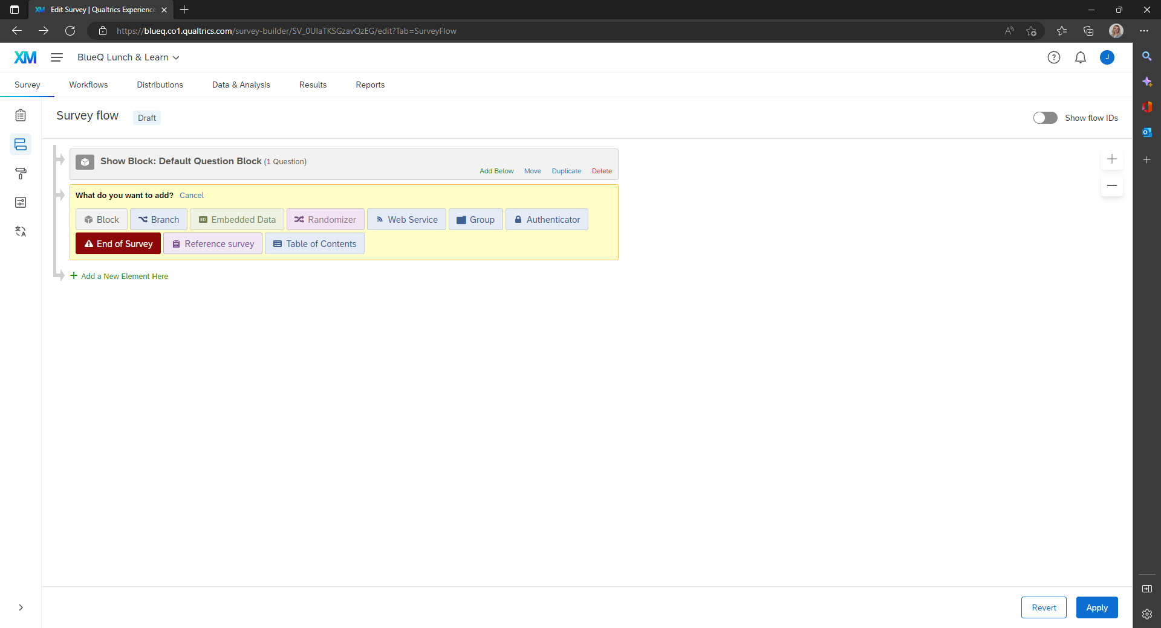
Creating the Survey: Logic & Flow
Survey Flow (qualtrics.com)

Slide 8
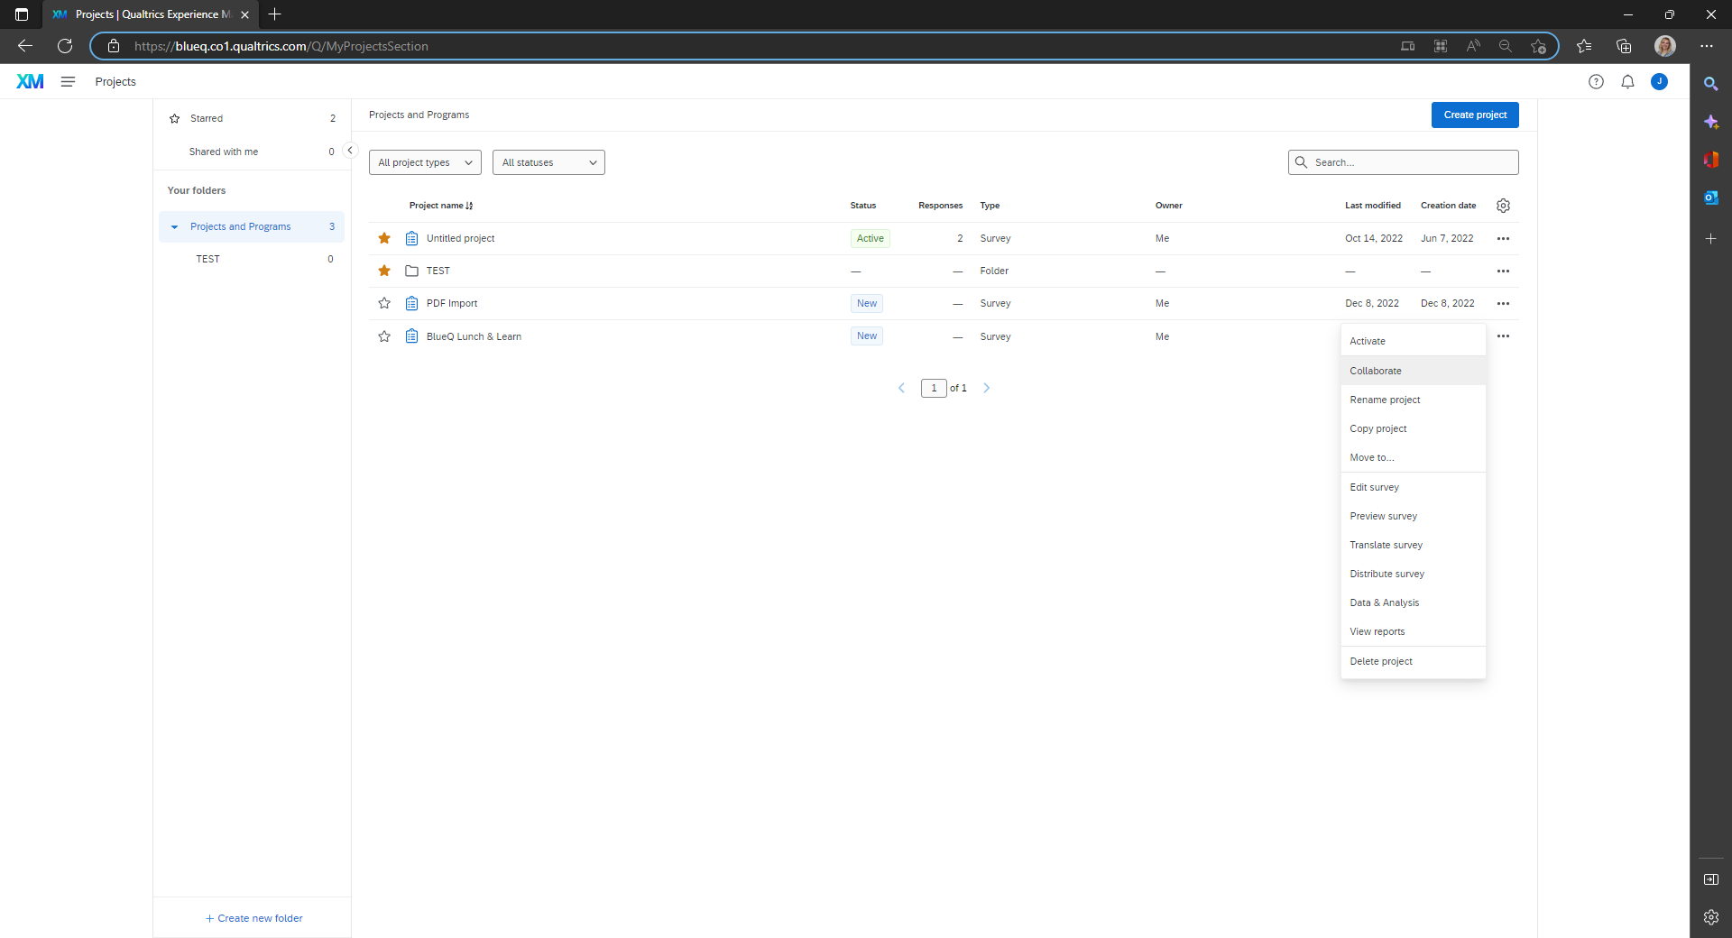
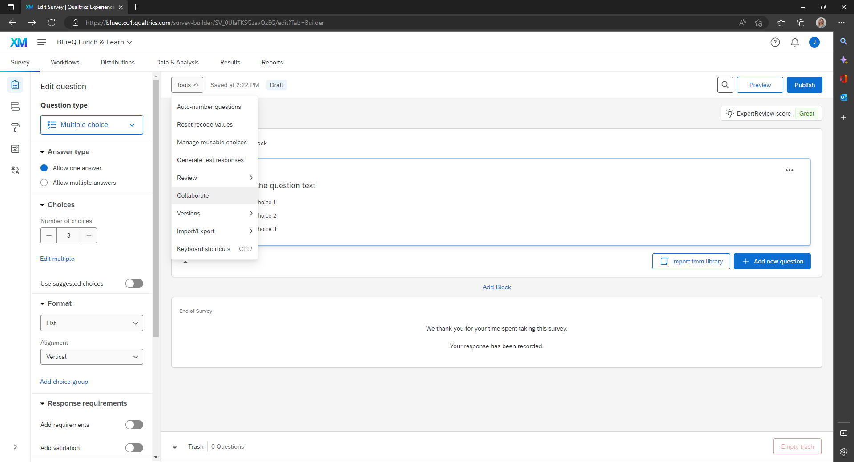
Creating the Survey: Adding Collaborators
From your list of projects
Once in the project
Collaborating on Projects (qualtrics.com)

Slide 9
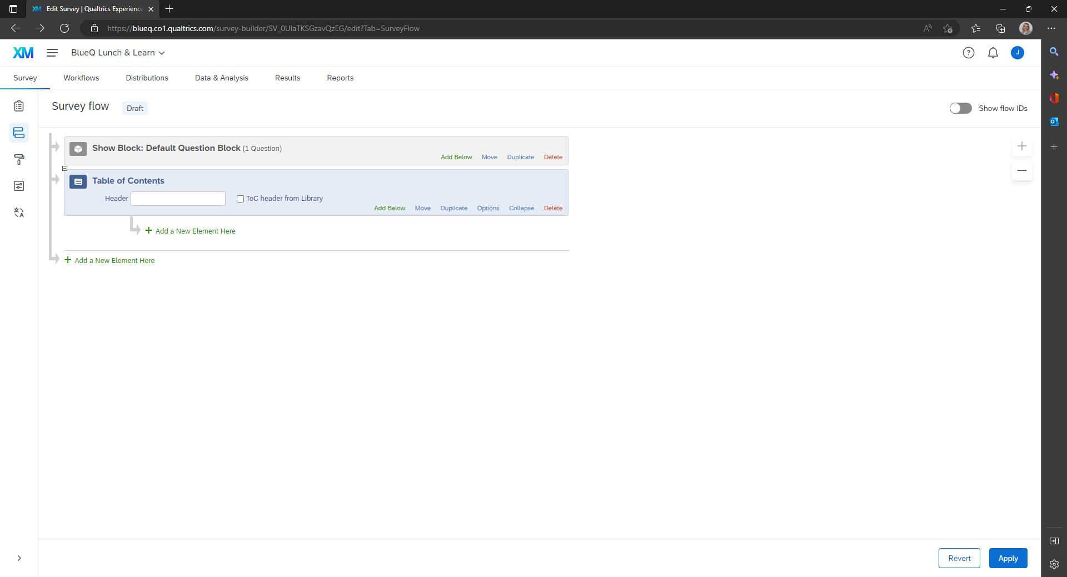
Creating the Survey: Table of Contents
Survey flow element
List of blocks in the survey (hint: add blocks!)
Navigation during the survey
Organizes questions
Table of Contents (qualtrics.com)

Slide 10
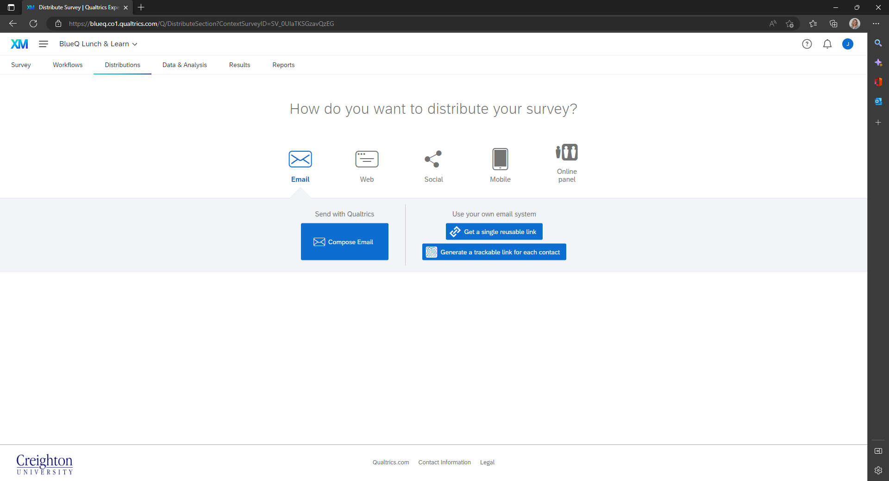
Creating the Survey: Distribution
Distributions Basic Overview (qualtrics.com)

Slide 11
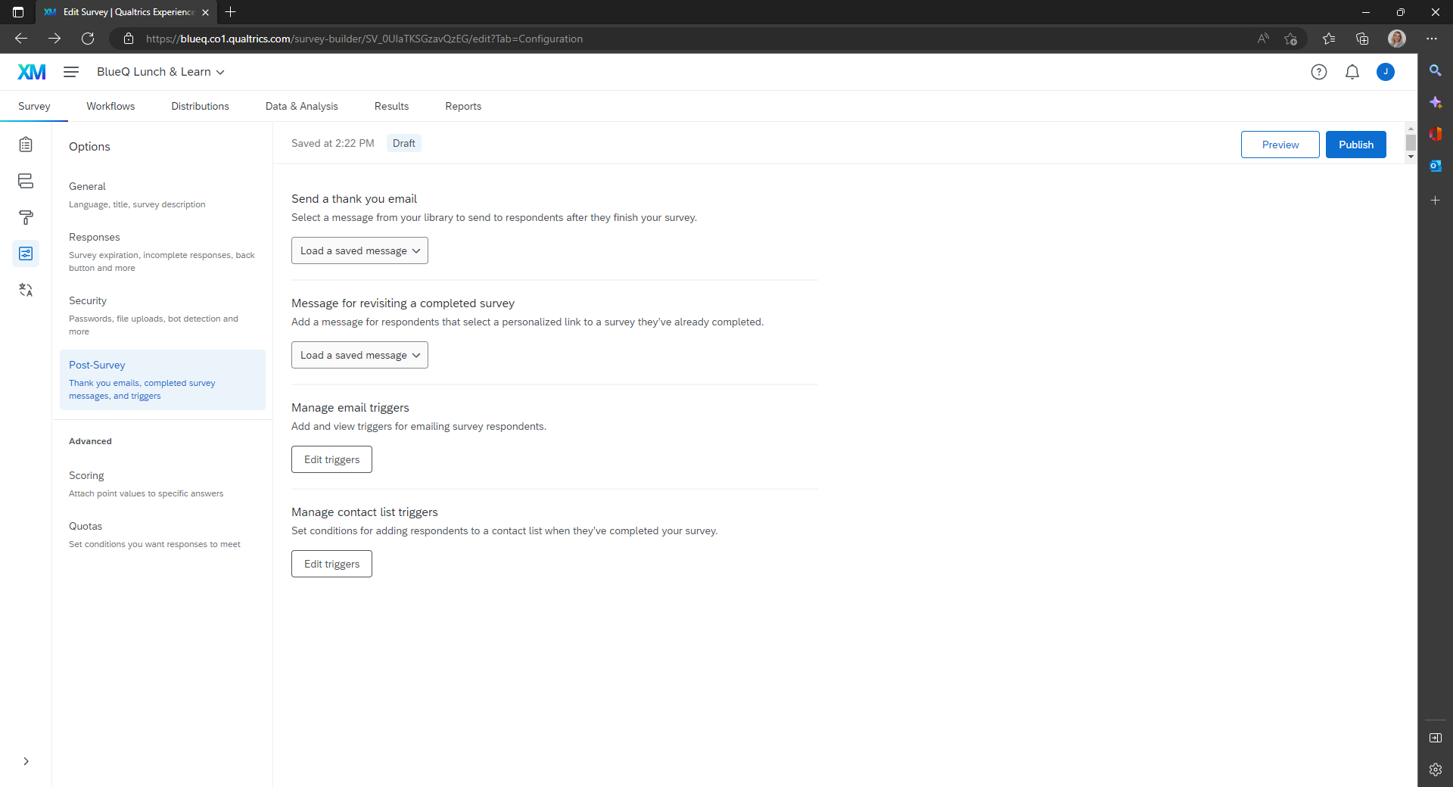
Post-Survey
Thank you email
Messages for revisiting completed survey
Email triggers

Slide 12
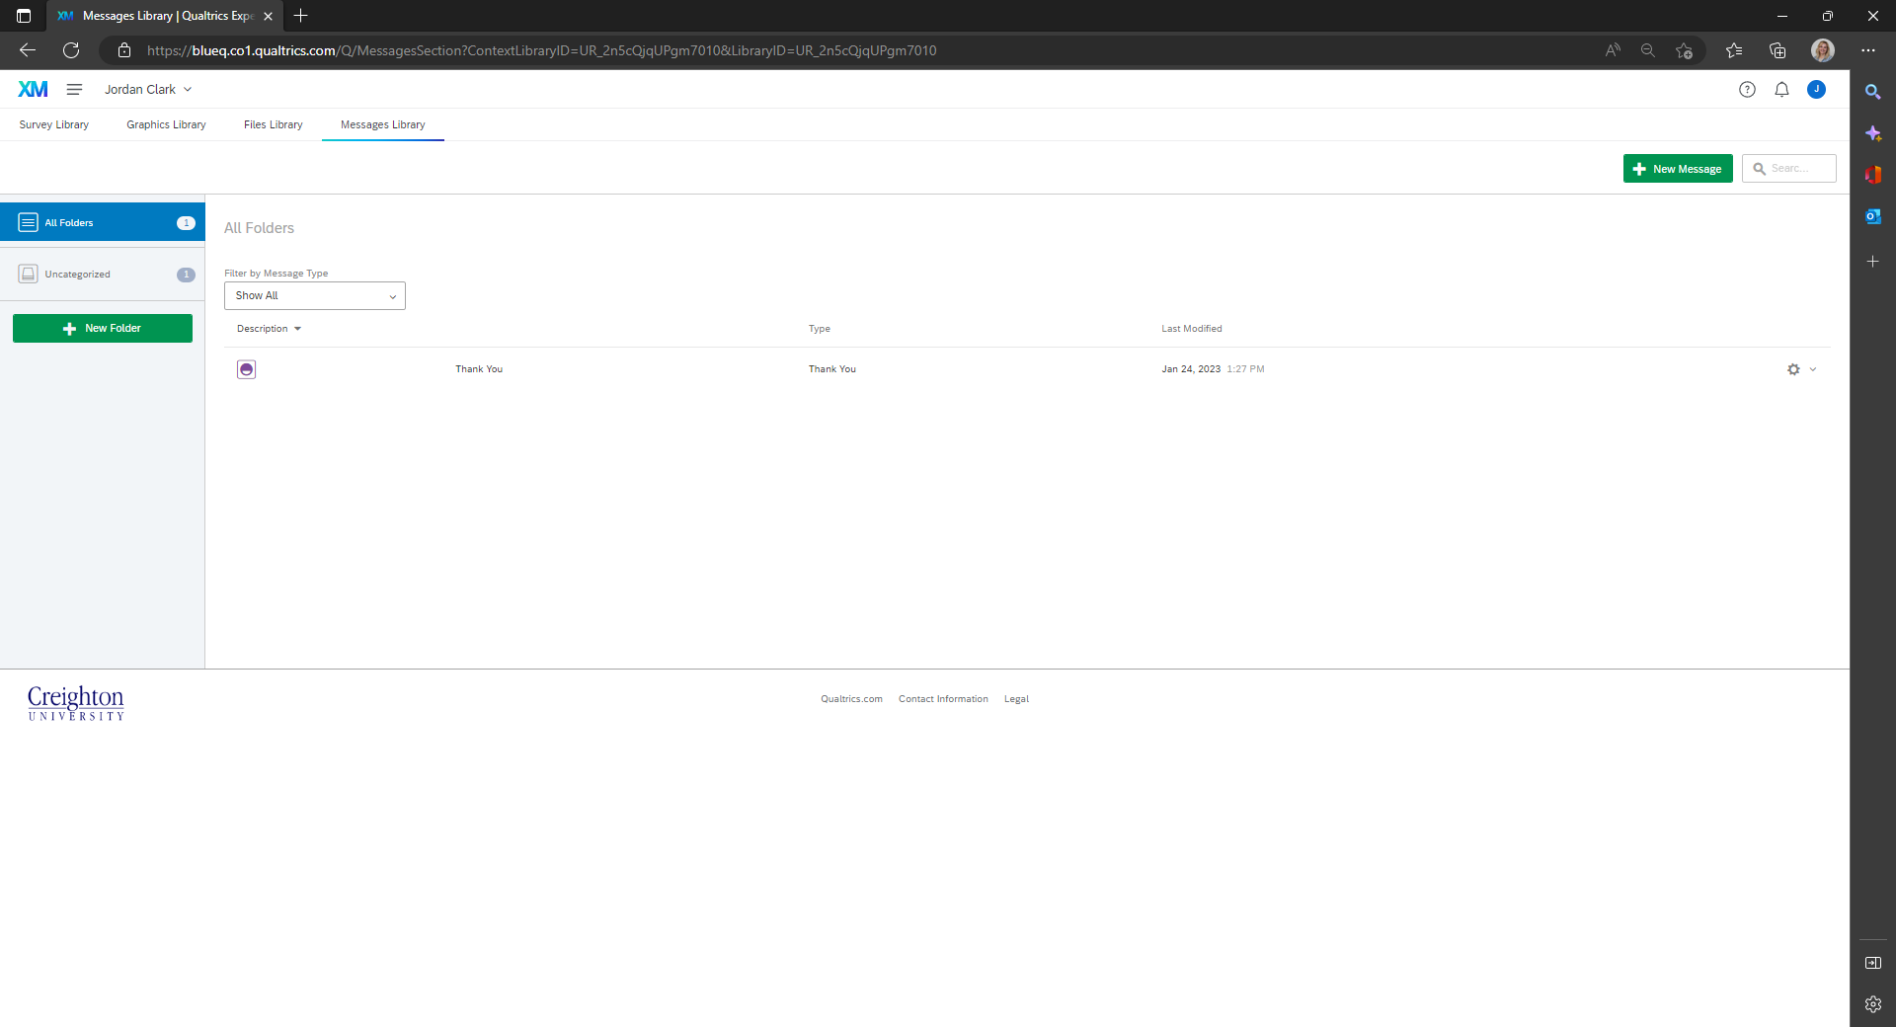
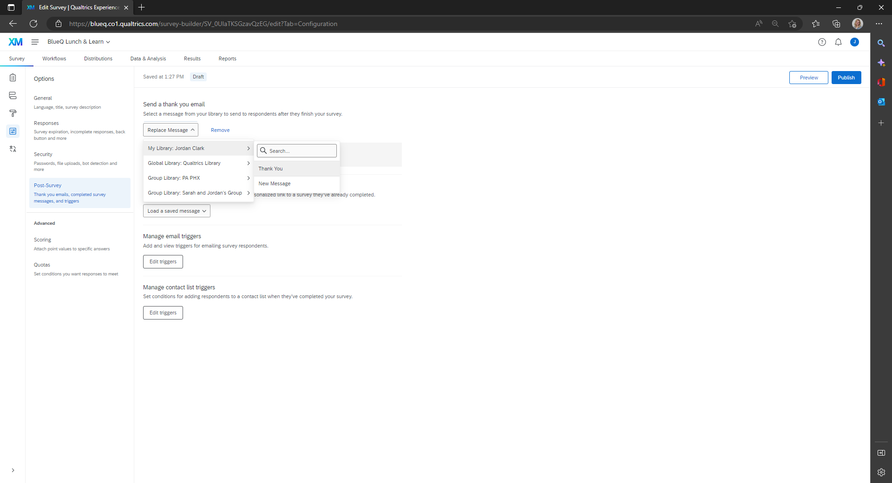
Library & Thank You Messages
Messages Library (qualtrics.com)

Slide 13
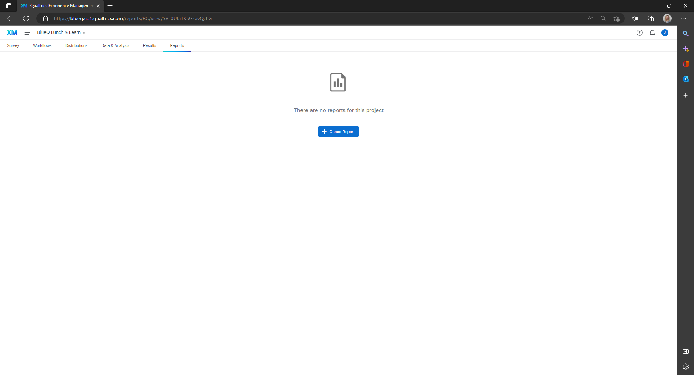
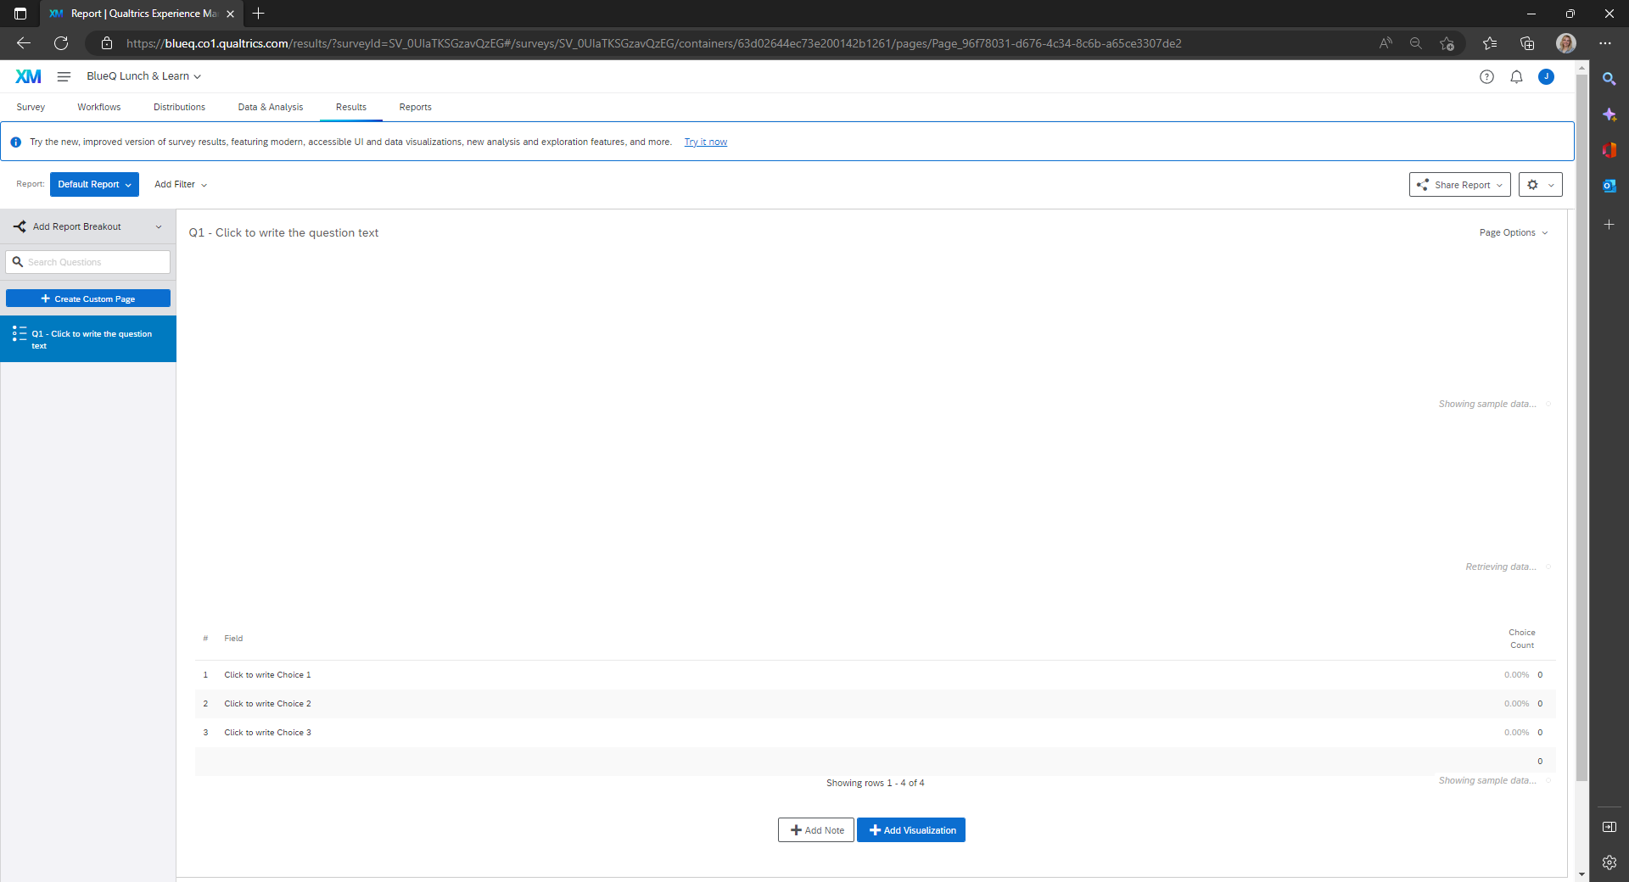
Results & Reports
Only available to owner
Results: default display
Reports: customized view of results
Results vs. Reports (qualtrics.com)

Slide 14
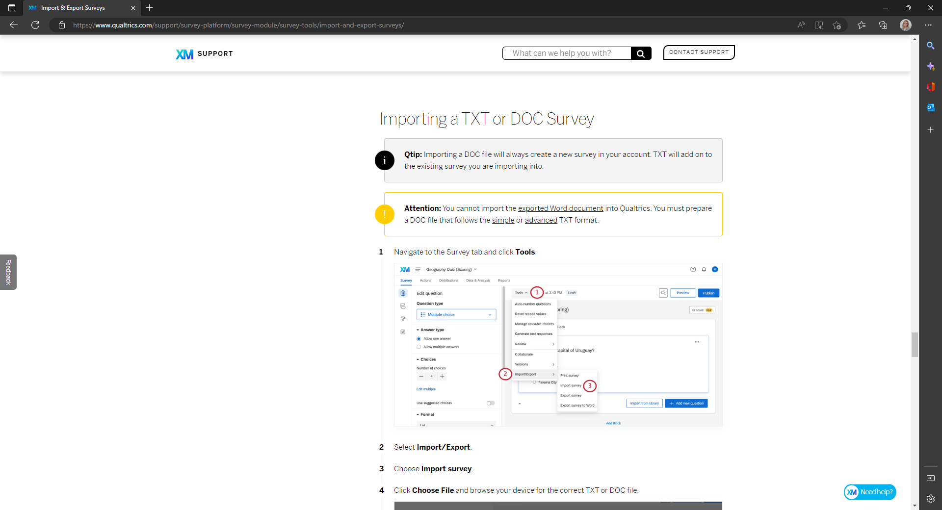
Creating a Survey from A PDF
Import & Export Surveys (qualtrics.com)

Slide 15

Email Triggers
Email Task (qualtrics.com)

Slide 16
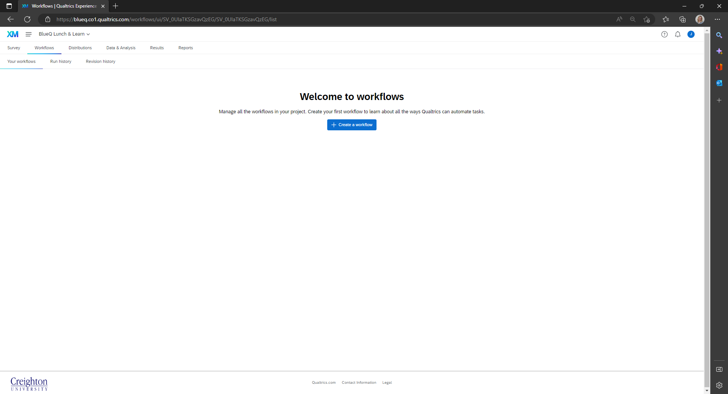
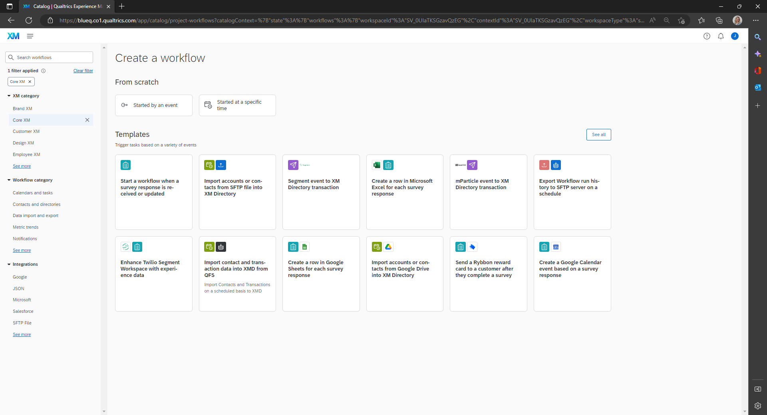
Workflows: What are they?
Workflows Basic Overview (qualtrics.com)
Utilizing Qualtrics Workflows

Slide 17
Workflows: Why you should use them.
Reliability
More features and functions
Better troubleshooting
Email triggers are not supported by Qualtrics

Slide 18
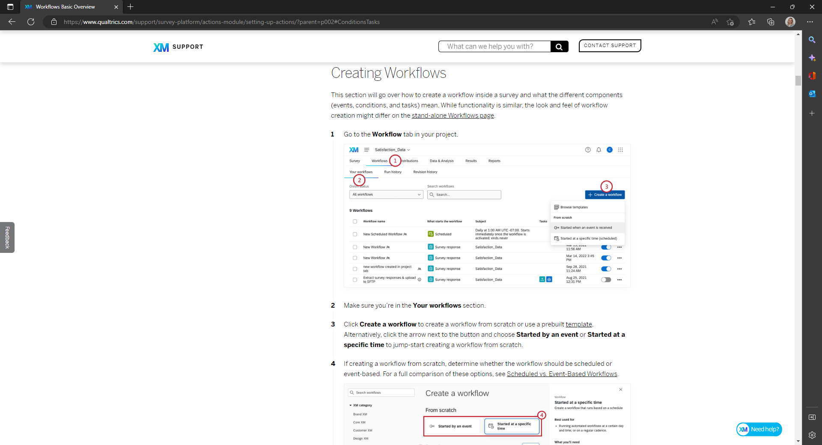
Workflows: Getting Started
Creating Workflows (qualtrics.com)

Slide 19
BlueQ Resources
Training Options for our Qualtrics Users:
Being logged in to BlueQ before accessing these, may facilitate easier access.
View a 47 minute Quick Start video which focuses mainly on the survey component.
Break it down: view six video segments (ranging from 7-25 minutes) that cover all major components.
24/7 Live Support
On-Demand Training
Certification Courses (EDU discounts available here)
Higher Education Community

Slide 20
Reporting Issues
For...
Malfunctions
Undeleting surveys
Requesting survey transfers
Determining survey owner...
Contact the BlueQ admin by submitting a ticket to the Service Desk!

